Slide 1

Claude 3’s Performance on the ConceptARC Benchmark: An Analogical Reasoning Assessment
Davide Mazza
Thomas Rosso

Slide 2
Overview
Study Focus: Evaluation of Claude 3’s abstract reasoning abilities.
Benchmark: ConceptARC, a series of visual analogy puzzles.
Comparison: Performance compared to humans and GPT-4.
Objective: Assess proficiency in various conceptual tasks and explore the impact of enhanced prompting techniques.
Significance: Provides insights into AI’s capabilities and limitations in achieving human-like reasoning.

Slide 3

Introduction
Abstract reasoning is a key area in cognitive science and AI research, involving pattern recognition and rule induction.
Large language models such as GPT-4 and Claude have shown emerging capabilities in tackling complex abstract reasoning tasks.
The study evaluates the abstract reasoning capabilities of Claude 3, a large language model developed by Anthropic.

Slide 4

Claude 3
Claude 3 is a large language model developed by Anthropic.
Advanced Architecture: Utilizes state-of-the-art neural network architectures to process and generate human-like text.
Enhanced Prompting: Capable of understanding and responding to complex prompts, improving its performance on challenging tasks.
Versatility: Can be applied to a wide range of applications, from conversational AI to problem-solving in specialized domains.

Slide 5

ConceptARC Dataset
Evaluates general abstract reasoning skills using visual analogy puzzles.
Composition:
528 tasks: 48 minimal and 480 standard.
16 conceptual categories (e.g., Above and Below, Complete Shape, Extract Objects).

Slide 6
Prompting strategies
Based on improved GPT-4 prompts.
Python notebook to interact with Claude 3’s API.
Prompt Structure:
Clear initial explanation of tasks.
JSON tasks converted to string format.
Up to three retries for incorrect answers.
Automated task submission, result checking, and retries.

Slide 7
Problems and Limitations
Usage Quota and Costs
Daily usage limits and API costs restricted testing.
Sample Size
Limited number of tasks tested, leading to potential bias.
Data Handling
Manual adjustments required for some tasks
Limited automation for large-scale testing.

Slide 8
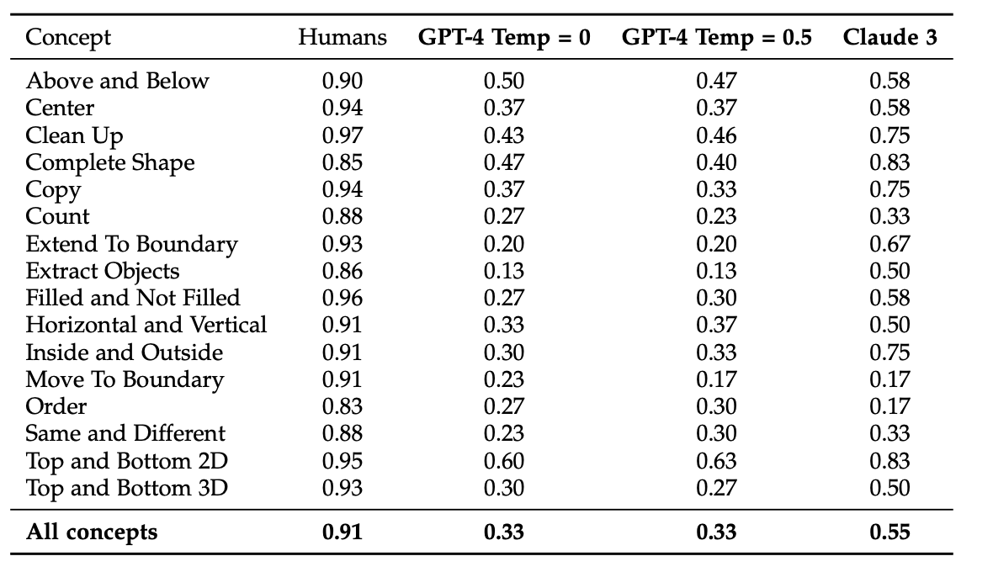
Results
Claude 3 shows improvement over GPT-4 but still lags behind human performance.
Strong performance in categories like "Clean Up" and "Complete Shape".
Struggles with categories like "Order" and "Move to Boundary".

Slide 9

Conclusions
Improvement: Claude 3 shows progress over GPT-4 but remains below human performance.
Bias: Results are influenced by limited sample size and usage constraints (daily quota and costs).
Future Work: Focus on refining prompting strategies and expanding dataset coverage.

Slide 10

Thank You for Your Attention!

